Slide 1

ID-02 – Developing Institutional and Individual Capacity
Andiswa Mlisa
GEO Secretariat
TC: Gregory Giuliani (Switzerland, UNIGE)
PoC: Hilcea Ferreira (Brazil, INPE)
IDIB: Mark Noort (Netherlands, HCP International)
4th Science & Technology Stakeholder Workshop, 24 March 2015, Norfolk, Virginia, USA

Slide 2
GEO Vision & Objectives
To realize a future wherein decisions and actions, for the benefit of humankind, are informed by coordinated, comprehensive and sustained Earth observations and information.
Improve and coordinate observation systems globally
Advance broad open data policies / practices
Foster increased use of Earth observation data and information

Slide 3
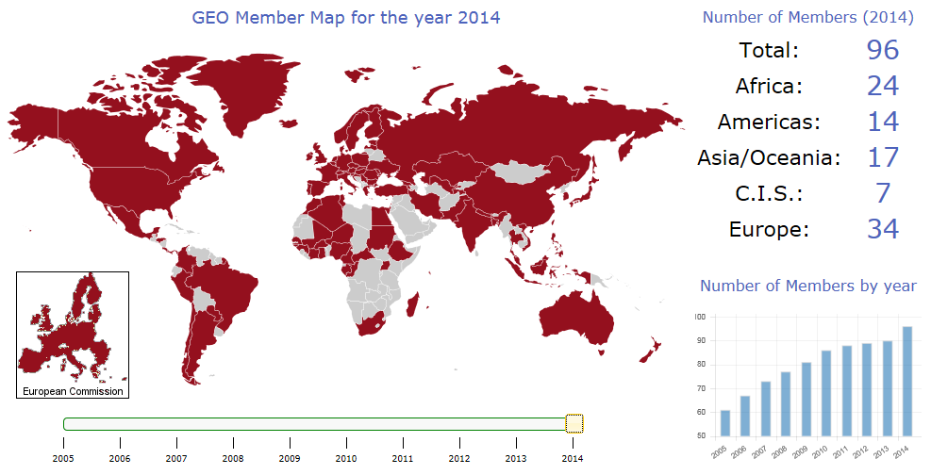

Slide 4

































































87 Participating Organizations (Nov 2014)

Slide 5
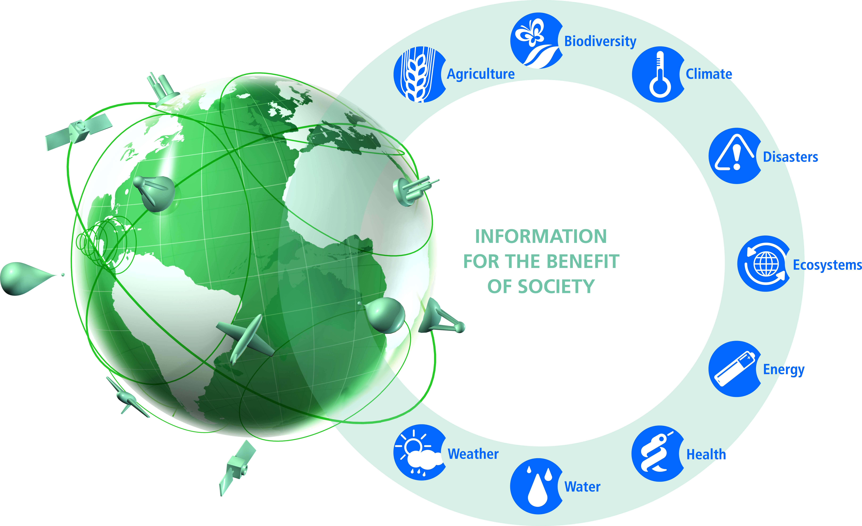
A Global, Coordinated, Comprehensive and Sustained System of Observing Systems
4 Cross-Cutting Tasks:
Data and Architecture (Infrastructure)
User engagement
Capacity Building
Science and Technology
GEOSS

Slide 6
GEO Capacity Building Strategy (GEOIII, 2006)
An approach based in three complementary and needed elements:
Infrastructure CB: hardware, software and other technology required to develop, access and use EO…
Individuals (Human) CB: education and training of individuals to be aware of, access, use and develop EO…
Institutional CB: building policies, programs & organizational structures in governments and organizations to enhance the understanding of the value of EO…
…data and products.
I³

Slide 7
Objectives
Identify, coordinate and build synergies between existing and future efforts.
Encourage & enable developing countries to identify and address their CB needs.
Enhance access to data and information, especially on a real-time and near real-time basis.
Encourage information and infrastructure sharing.
Prioritize the inclusion of CB as a component of all GEO societal benefit and transverse areas.
Facilitate coordination among GEO Members and Participating Organizations as they seek further resources for identified CB priorities.

Slide 8
Challenges of Developing Countries…
The challenges for developing countries can be summarized in 5 main items:
Improved access to data (for example internet based solutions for accessing data are inadequate for developing countries, alternative solutions are needed; and support with inclusion of GEO Data Sharing Principles into national policies);
Improved knowledge and skills;
Improved infrastructure;
Improved coordination of activities to reduce duplication; and
Improved availability and management of resources;

Slide 9
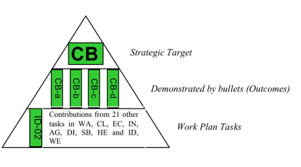
GEOSS Strategic Target
Enhance the coordination of efforts to strengthen individual, institutional and infrastructure capacities, particularly in developing countries, to produce and use Earth observations and derived information products.
This will be demonstrated by:
Networking activities that specifically build individual, institutional and infrastructure capacity.
Leveraging resources for Earth observation capacity building efforts.
Increased use of Earth observation in policy and decision making.
Enhanced participation of developing countries in GEO and GEOSS.
Target Assessment, 2014:
Capacity building activities are increasing in number and forces are joined to enhance capacity building initiatives. Twenty-one of the WP tasks have elements of capacity building activity, responding in some way to the one or more of the demonstrated by actions of the target. The activity level between these varies from small to robust. The spread of capacity building activities in the WP further highlights the cross–cutting nature of capacity building and the need for more robust coordination. The integration of the capacity development resource facility and the GEO web portal and initiatives in the framework of AfriGEOSS will give a further boost to capacity building.

Slide 10



















Summary Achievements
Workshops (training, awareness & dissemination), ground infrastructure, spatial data infrastructure, data access, open source software, data-products-services portals
Agriculture (e.g. AgriCab)
Disasters (e.g. SERVIR)
Energy (e.g. EnerGEO)
Forest Monitoring (e.g. Third Country Training Program, INPE-FAO Work Programme, GEONETCast and AgriCab)
Health (e.g. EO2Heaven)
Weather (e.g. Vlab, Afrimet, Cimhet)
Networking, promotion (success stories and marketing toolkits), user requirements, impact assessments, guidelines & methodologies, (e.g. GEONETCab, EOPOWER, SA-GEO, NCRS-Madagascar, AfriGEOSS, SERVIR, ITC)
Software & systems (e.g. SERVIR, Terraview, TerraLib, Ilwis, DevCoCast, GNC Toolbox, Afroimaison, EnviroGRIDS)

Slide 11
GEOSS GCI and Data Core
A number of items are registered in the GEOSS Common Infrastructure & Datasets contributed to the GEOSS Data CORE
GEOCAB Portal
GEONETCast Toolbox, 52north.org
GeonetCab Capacity Building Portal
TerraLib
INPE Data Catalog
EnviroGRIDS portal
20 services by enviroGRIDS partners
AfroMaison CSW, WMS, WFS, WCS and broker services
GeoNetCast Americas dissemination of DevCoCast products in Portuguese and Spanish and list of Environmental Satellite Data, Products and Software

Slide 12
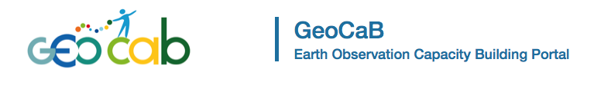
http://www.geocab.org/
590 registered capacity building resources (07.11.2014)
By Type
Organization (208)
Raw EO Product (81)
Training (71)
Software (37)
Success Story (29)
Tutorial (24)
Marketing tool Kit (23)
...
By SBA
Biodiversity (246)
Climate (252)
Disaster (57)
Ecosystem (378)
Water (314)
Weather (206)
Energy (238)
Health (185)
Agriculture (297)

Slide 13
GEO Strategic Plan 2016-2025 (March 2015)
Strategic Objective: GEO will ENGAGE with stakeholder communities to address global and regional challenges by deepening the understanding of Earth system processes and improving the links between scientific understanding and policy-making.
Capacity building, as well as enhancement and retention of existing capacity, are critical for developing Members’ competencies to use Earth observations efficiently for responding to societal challenges and addressing sustainable development. To further these goals, GEO will therefore:
  promote engagement with developing countries;
  assist developing countries and regions in increasing their capacity to acquire, share, store, maintain and utilize Earth observation data and information; and
  foster regional cooperation.

Slide 14
Reflections & Considerations …
Who’s capapcity are we building?
Where in the value chain is our focus?
Where do the needs for capacity building come from?
Is the solution being provided fit for purpose?
How sustainable are the solutions we providing?
Who is providing capacity building? Who is we?
Where do resources come from?
Are we aware of duplication of efforts and gaps?
How quickly can we respond to needs?
What is the impact of our capacity building activities?
What are the indicators for assessing impact?
What arrangement structure would be effective for implementing capacity building in GEO?

Slide 15
Reflections & Considerations …
GEO is based on voluntary contributions
  Existing initiatives, programmes & projects (mandate & funding available)
  Specific proposal calls
  Resources from the GEO Trust Fund (mainly mobility funding)
Assume contributions will respond to goals and objectives
Need a systematic approach to respond to user needs
Self-organization community is not as effective as we would like it to be

Slide 16
Reflections & Considerations …
Build on current GEO Capacity Building Strategy – focus on Individual, Institutional and Infrastructure
improve access to EO resources (make it easy for people to find information, tutorials and opportunities for courses = function of GEOCAB)
fill gaps in the critical path towards proficiency in EO applications (match the demand with offers from GEO members)
provide synchronization and coordination for all the capacity building efforts in and related to GEO
provide opportunities for capacity building (stimulate GEO members to offer training for participants)

Slide 17
Reflections & Considerations …
Capacity building a Foundation Task
Establish a focus group (5 – 10 people), with institutional commitment, to:
  Periodic review of the resource facility (relevance and maintenance)
  Periodic review of user requirements
  Develop and maintain resource providers database
  Undertake brokering - match needs with capabilities and pledged resources
  Resource mobilization
  Dedicated events organization
  Indicators – as input to M&E and impact assessment
Support from the Trust Fund (beyond mobility funds for developing countries)

Slide 18
Upcoming Events
Workshop on Capacity Building and Developing Countries in GEO Post 2015, 4 May 2015 in Geneva, Switzerland
GEO Work Plan Symposium, 5 -7 May 2015, Geneva, Switzerland
GEO-XII Plenary and Ministerial Summit, 11 – 13 November 2015, Mexico City, Mexico

Slide 19
THANK YOU

